Slide 1
Personal Software Process
for Engineers: Part I
Estimating with PROBE II
SM

Slide 2
Lecture Topics
The prediction interval
Organizing proxy data
Estimating with limited data
Estimating accuracy
Estimating considerations

Slide 3
The Prediction Interval
The prediction interval provides a likely range around the estimate.
  A 70% prediction interval gives the range within which the actual size will likely fall 70% of the time.
  The prediction interval is not a forecast, only an expectation.
  It applies only if the estimate behaves like the historical data.
  It is calculated from the same data used to calculate the regression parameters.

Slide 4
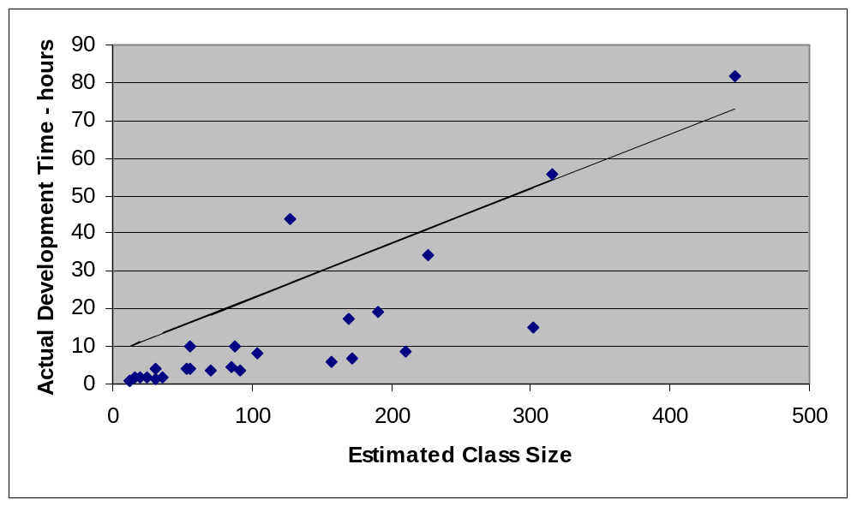
A Prediction Interval Example
27 C++ programs

Slide 5
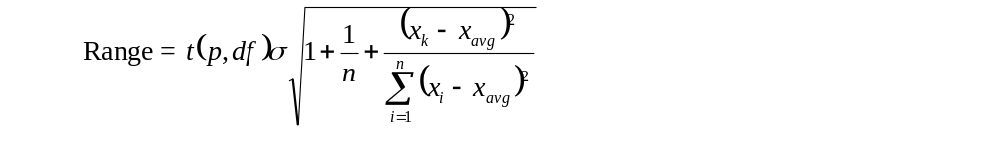
The Range Calculation
The range defines the likely error around the projection within which the actual value is likely to fall.
Widely scattered data will have a wider range than closely bunched data.
The variables are
  n - number of data points
  σ - the standard deviation around the regression line
  t(p, df) - the t distribution value for probability p (70%) and df (n-2) degrees of freedom
  x - the data: k - the estimate, i - a data point, and avg - average of the data

Slide 6
The Standard Deviation Calculation
The standard deviation measures the variability of the data around the regression line.
Widely scattered data will have a higher standard deviation than closely bunched data.
The standard deviation σ is the square root of the variance.

Slide 7
Calculate the Prediction Interval
Calculate the prediction range for size and time for the example in lecture 3 (slides 42 and 43).
Calculate the upper (UPI) and lower (LPI) prediction intervals for size.
  UPI = P + Range = 538 + 235 = 773 LOC
  LPI = P - Range (or 0) = 538 - 235 = 303 LOC
Calculate the UPI and LPI prediction intervals for time.
  UPI = Time + Range = 1186 +431 = 1617 min.
  LPI = Time - Range (or 0) = 1186 - 431 = 755 min.

Slide 8
Organizing Proxy Data -1
To make an estimate
break the planned product into parts
relate these planned parts to parts that you have already
built
use the size of the previously-built parts to estimate the
sizes of the new parts
To do this, you need size ranges for the types of parts that you typically develop.
For each product type, you also need size ranges to help you to judge the sizes of the new parts.

Slide 9
Organizing Proxy Data -2
To determine the size ranges, start with the part data.
Assume that you have the following data.
  class A, three items (or methods), 39 total LOC
  class B, five items, 127 total LOC
  class C, two items, 64 total LOC
  class D, three items, 28 total LOC
  class E, one item, 12 LOC
  class F, two items, 21 total LOC
The LOC per item is 13, 25.4, 32, 9.333, 12, 10.5.
The objective is define size ranges that approximate our intuitive feel for size.

Slide 10
Organizing Proxy Data -3
To produce the size ranges, sort the data as follows.
The sorted LOC per item data: 9.333, 10.5, 12, 13, 25.4, 32.
Arrange these data as follows.
Pick the smallest item as very small: VS = 9.333.
Select the largest item as very large: VL = 32.
Pick the middle item as medium: M = 12 or 13.
For the large and small ranges, pick the midpoints
between M and VS and M and VL: 10.9, and 22.25.
While these may be useful ranges, they are probably not stable.
That is, additional data points will likely result in substantial size-range adjustments.

Slide 11
Intuitive Size Ranges -1
In judging size, our intuition is generally based on a normal distribution.
That is, we think of something as of average size if most such items are about that same size.
We consider something to be very large if it is larger than almost all items in its category.
When items are distributed this way, it is called a normal distribution.
With normally distributed data, the ranges should remain reasonably stable with the addition of new data points.

Slide 12
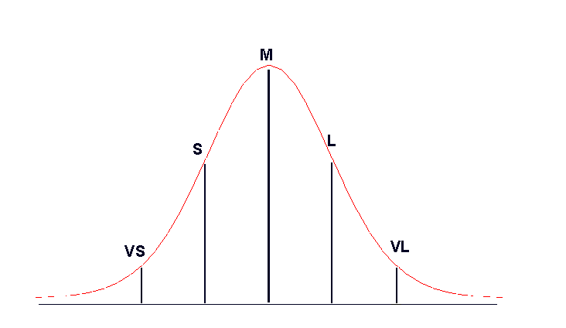
Intuitive Size Ranges -2
A normal distribution

Slide 13
Intuitive Size Ranges -3
With a large volume of data, you could calculate the mean and standard deviation of that data.
For the size ranges
  Medium would be the mean value.
  Large would be mean plus one standard deviation.
  Small would be mean minus one standard deviation.
  Very large would be mean plus two standard deviations.
  Very small would be mean minus two standard deviations.
This method would provide suitably intuitive size ranges if the data were normally distributed.

Slide 14
The Distribution of Size Data
Program size data are not normally distributed.
  many small values
  a few large values
  no negative values
With size data, the mean minus one or two standard deviations often gives negative size values.
The common strategy for dealing with such distributions is to treat it as a log-normal distribution.

Slide 15
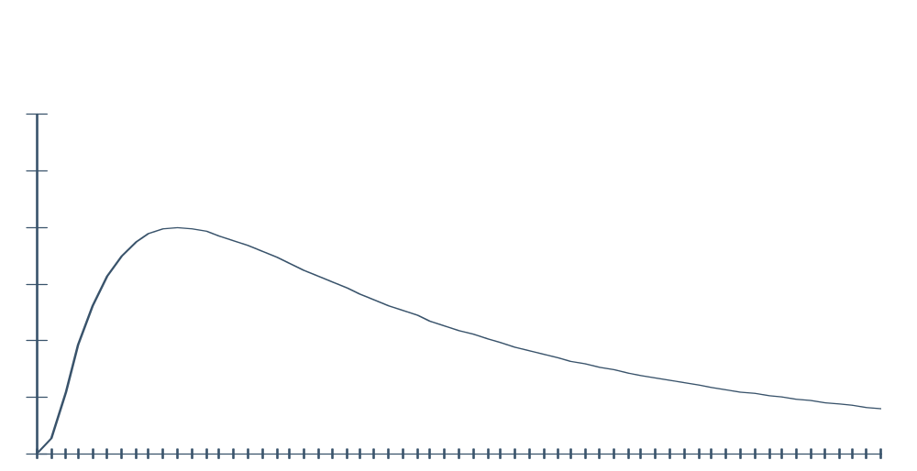
A Log-Normal Distribution

Slide 16
The Log-Normal Distribution
To normalize size data, do the following:
Take the natural logarithm of the data.
Determine the mean and standard deviation of the log data.
Calculate the average, large, very large, small, and very small values for the log data.
Take the inverse log of the ranges to obtain the range size values.
This procedure will generally produce useful size ranges.

Slide 17
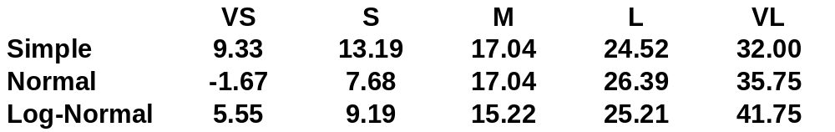
Organizing Proxy Data -4
A mathematically precise way to determine the proxy size ranges is described in the text (pages 78-79).
This simple way to determine these size ranges will work when you have lots of data. Otherwise, it can cause underestimates.
Comparative estimating ranges

Slide 18
Estimating with Limited Data -1
Even after using PSP for many projects, you will have to
make estimates with limited data when you
  work in a new environment
  use new tools or languages
  change your process
  do unfamiliar tasks
Since estimates made with data are more accurate than
guesses, use data whenever you can.
Use the data carefully since improper use can lead to
serious errors.

Slide 19
Estimating with Limited Data -2
Depending on the quality of your data, select one of the four PROBE estimating methods.
Method
A | regression with estimated proxy size
B | regression with plan added and modified size
C | the averaging method
D | engineering judgment
To use regression method A or B, you need
  a reasonable amount of historical data
  data that correlate
  reasonable β₀ and β₁ parameter values

Slide 20
Method A (Regression): Estimated Proxy Size
Method A uses the relationship between estimated proxy size (E) and actual
  added and modified size
  development time
The criteria for using this method are
  three or more data points that correlate (R² > 0.5)
  reasonable regression parameters (table 6.6 on pg. 96)
  completion of at least three exercises with PSP1 or higher

Slide 21
Method B (Regression): Plan Added and Modified Size
Method B uses the relationship between plan added and modified size and
  actual added and modified size
  actual development time
The criteria for using this method are
  three or more data points that correlate (R² >0.5)
  reasonable regression parameters (table 6.6 on pg. 96)
  completion of at least three exercises with PSP0.1 or higher

Slide 22
Method C: Averaging
Method C uses a ratio to adjust size or time based on historical averages.
The averaging method is easy to use and requires only one data point.
Averages assume that there is no fixed overhead.
The averaging method is described in the PROBE script in table 6.6 on page 96.

Slide 23
Method D: Engineering Judgment
Use method D when you don’t have historical data. Use judgment to
  project the added and modified size from estimated part size
  estimate development time
Use method D when you cannot use methods A, B, or C.

Slide 24
Estimating Accuracy
Planning is a skill that must be developed.
  The PSP helps to build planning skills.
  Even simple plans are subject to error.
    unforeseen events
    unexpected complications
    better design ideas
    just plain mistakes
The best strategy is to plan in detail.
  Identify the recognized tasks.
  Make estimates based on similar experiences.
  Make judgments on the rest.

Slide 25
Combining Estimates
To combine multiple estimates made by a single developer
  add the estimates for the separate parts
  make one linear regression calculation
  calculate one set of prediction intervals
Multiple developers can combine independently-made estimates by
  making separate linear regression projections
  adding the projected sizes and times
  adding the squares of the individual ranges and taking the square root to get the prediction interval

Slide 26
Estimating Error: Example
When estimating in parts, the total error will be less than the sum of the part errors.
  Errors tend to balance out.
  This assumes no common bias.
For a 1000-hour job with estimating accuracy of ± 50%, the estimate range is from 500 to 1500 hours.
If the estimate is independently made in 25 parts, each with 50% error, the
  total would be 1000 hours, as before
  estimate range would be from 900 to 1100 hours

Slide 27
Combining Individual Errors
To combine independently-made estimates
  Add the estimated values.
  Combine the variances (squares) of the errors.
With 25 estimates for a 1000-hour job
  Each estimate averages 40 hours.
  The standard deviation is 50%, or 20 hours.
  The variance for each estimate is 400 hours.
  The variances add up to 10,000 hours.
  The combined standard deviation is the square root of the sum of the variances, or 100 hours.
  The estimate range is 900 to 1100 hours.

Slide 28
Class Exercise -1
Start with three estimates.
  A = 45 hours, + or - 10
  B = 18 hours, + or - 5
  C = 85 hours, + or - 25
What is the combined estimate?

Slide 29
Class Exercise -2
Start with three estimates.
  A = 45 hours, + or - 10
  B = 18 hours, + or - 5
  C = 85 hours, + or - 25
What is the combined estimate?
  total = 45 + 18 + 85 = 148 hours
What is the combined estimate range?

Slide 30
Class Exercise -3
Start with three estimates.
  A = 45 hours, + or - 10
  B = 18 hours, + or - 5
  C = 85 hours, + or - 25
What is the combined estimate?
  total = 45 + 18 + 85 = 148 hours
What is the combined estimate range?
  variance = 100 + 25 + 625 = 750
  range = square root of variance = 27.4 hours
What is the combined UPI and LPI?

Slide 31
Class Exercise -4
Start with three estimates.
  A = 45 hours, + or - 10
  B = 18 hours, + or - 5
  C = 85 hours, + or - 25
What is the combined estimate?
  total = 45 + 18 + 85 = 148 hours
What is the combined estimate range?
  variance = 100 + 25 + 625 = 750
  range = square root of variance = 27.4 hours
What is the combined UPI and LPI?
  UPI = 148 + 27.4 = 175.4 hours
  LPI = 148 – 27.4 = 120.6 hours

Slide 32
Using Multiple Proxies
With size/hour data for several proxies
  estimate each as before
  combine the total estimates and prediction intervals as just described
Use multiple regression if
  there is a correlation between development time and each proxy
  the proxies do not have separate size/hour data
Multiple regression is covered in exercise hints for the final PSP exercise.

Slide 33
Estimating Considerations
While the PROBE method can provide accurate estimates, improper use of data can lead to serious errors.
One extreme point can give a high correlation even when the remaining data are poorly correlated.
Similarly, extreme points can lead to erroneous β₀ and β₁ values, even with a high correlation.

Slide 34
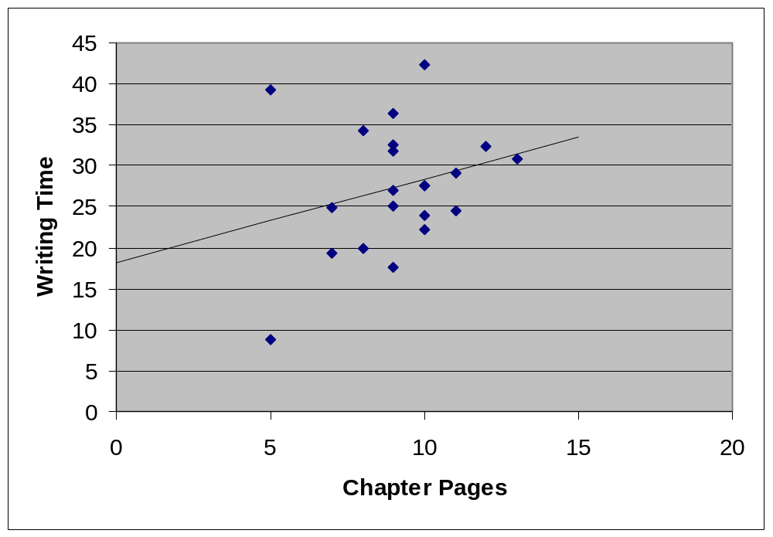
Correlation with Grouped Data
r = 0.26

Slide 35
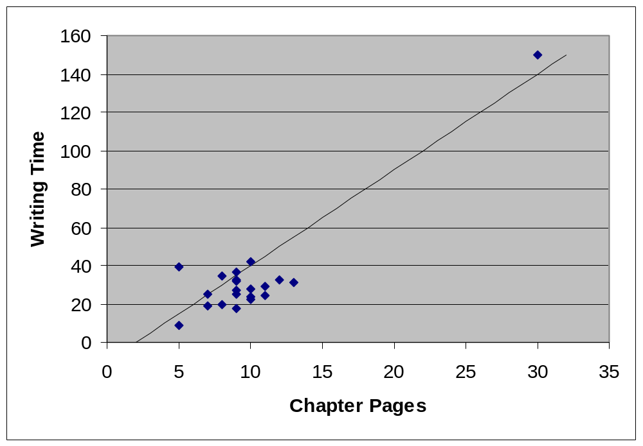
Correlation with an Extreme Point
r = 0.91

Slide 36
Conclusions on Misleading Data
With only one point moved to an extreme value, the correlation for the same data increased from 0.26 to 0.91.
Similarly, the β₀ and β₁ values changed from
18.23 to -17,76 for β₀
1.02 to 5.08 for β₁
With an average productivity of 3.02 and 3.31 hours per page, both of these β₁ values are misleading.
With one extreme point, you probably should not use regression.

Slide 37
Messages to Remember
The PROBE method provides a structured way to make size and development time estimates.
  It uses your personal development data.
  It provides a statistically sound range within which actual program size and development time are likely to fall.
With a statistically sound estimating method like PROBE, you can calculate the likely estimating error.

